Slide 1






SERMONER: PROPHET SOLA ODUBOWALE
October 4th 2026

Slide 2




Slide 3
  It is the act of raising yourself up in status or importance, often boasting or putting others down.

Slide 4
2. It is taking credit for what only God can do.

Slide 5
3. It is boasting in your accomplishments.

Slide 6
4. It is seeking human praise and downplaying God’s role in your life.

Slide 7
5. It is when a man is blind to correction, inflated his ego and distance himself from humility.

Slide 8
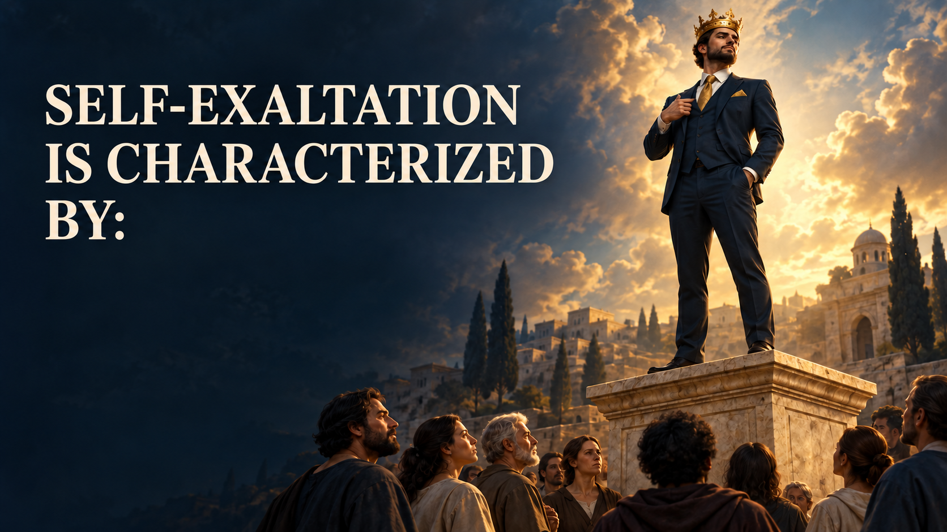

Slide 9
  Pride and arrogance: believing you are better, smarter, or more important.

Slide 10
2. Self-praise: constantly talking about your own accomplishments and seeking personal glory.

Slide 11
3. Comparison: Measuring yourself against others to make yourself look superior.

Slide 12


Slide 13
  Separation from God.
(James 4:6, Psalm 138:6)

Slide 14
2. Fall and Destruction.
(Proverb 29:23)

Slide 15
3. Loss of Grace.
(1 Peter 5:5)

Slide 16
4. It blinds us to our limitations. (Isaiah14:13-15)

Slide 17
5. It makes us unreachable.
(Proverb 26:12)

Slide 18
6. It fuels comparison and rivalry.
(2 Corinthians 10:12)

Slide 19
7. It brings suggest fall.
( Acts 12:22-23)

Slide 20
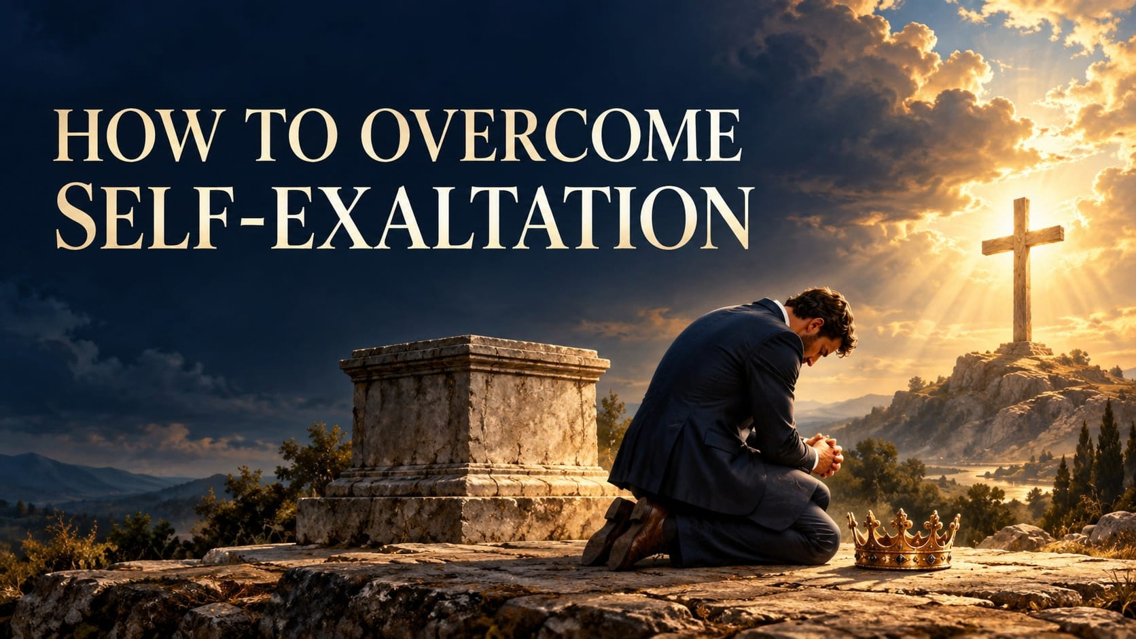

Slide 21



  Recognize pride in your life.

Slide 22
2. Cultivate humility.
(Philippians 2:3)

Slide 23
3. Depend on God.
( Proverb 3:5-6)

Slide 24

4. Submit to God’s authority. (James 4:7)

Slide 25


Slide 26
  Access to God’s Grace. ( 1 Peter 5:5)

Slide 27
2. Exaltation by God.
(James 4:10)

Slide 28
3. Peace in Relationships.
(Ephesians 4:2-3)

Slide 29
4. Spiritual Growth.
(Psalm 25:9)

